Slide 1
Geo APIs
February 18th 2013
Smart Data Hack
http://gogeo.blogs.edina.ac.uk

Slide 2
Overview
Maps in your apps
Going beyond just showing maps
Geospatial data: it isn’t just maps
http://gogeo.blogs.edina.ac.uk

Slide 3
Back to Google, Bing and Here (Nokia)
These don’t just offer map data
Each service has a suite of APIs for JavaScript, iOS, Android, HTML5 etc.
https://developers.google.com/maps/
http://www.microsoft.com/maps/developers/web.aspx
http://developer.here.net/en_GB
http://gogeo.blogs.edina.ac.uk

Slide 4
Going beyond just showing maps
Adding other Layers

Slide 5
Leaflet: http://leafletjs.com/
Easy to use
Nice default graphics
Very light weight
Not very flexible
Only uses GeoJSON or Native layers
You may need to parse your data before it will work
http://gogeo.blogs.edina.ac.uk

Slide 6
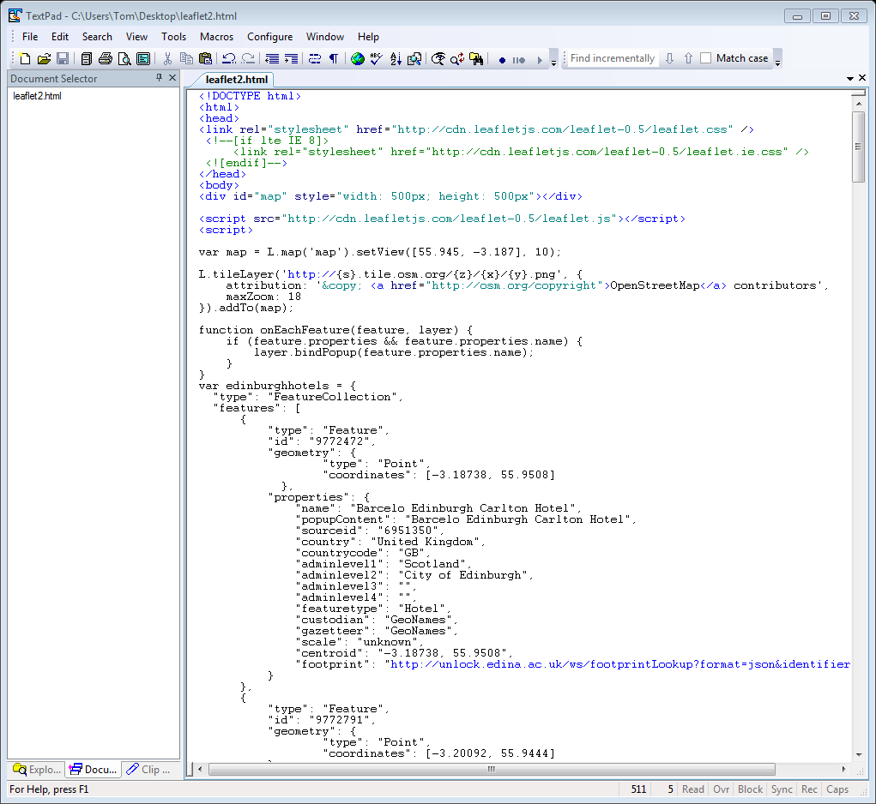
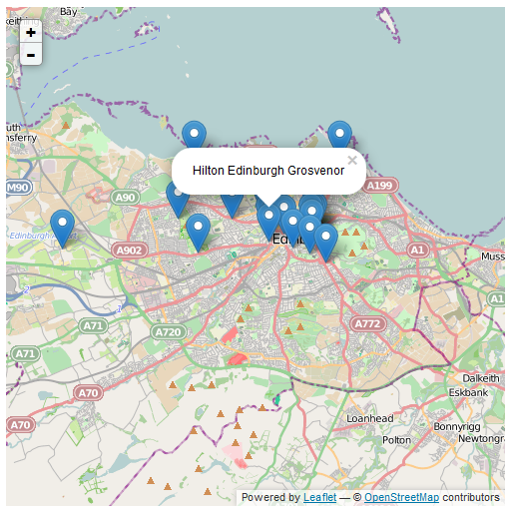
Leaflet: http://leafletjs.com/
http://gogeo.blogs.edina.ac.uk

Slide 7
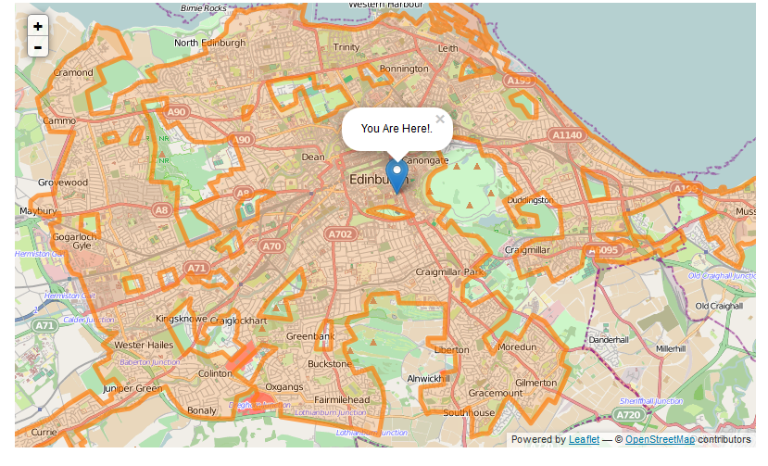
Leaflet: http://leafletjs.com/
http://gogeo.blogs.edina.ac.uk

Slide 8
OpenLayers: http://openlayers.org/
Very Powerful
Open Source with a huge user community
Much more flexible for reading in different datasets
Not as easy to use
Defaults settings and visuals are a little ugly
Larger Codebase, harder to streamline for mobile devices
http://gogeo.blogs.edina.ac.uk

Slide 9
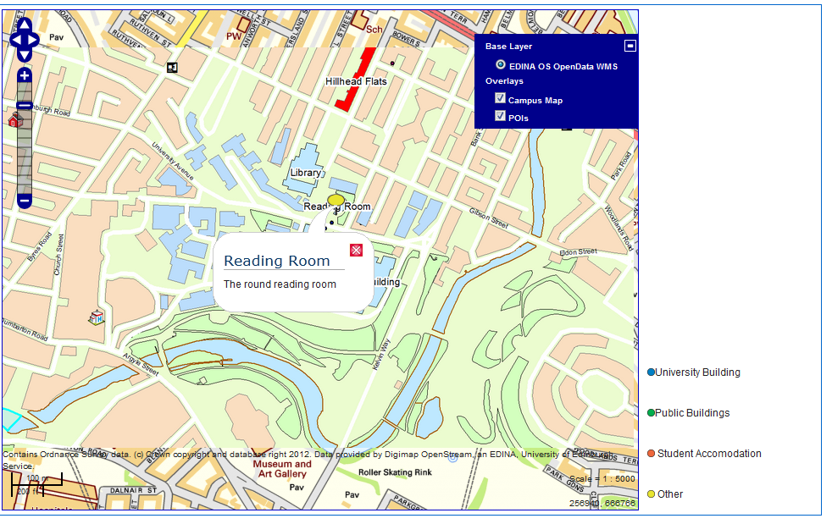
OpenLayers: http://openlayers.org/
http://gogeo.blogs.edina.ac.uk

Slide 10
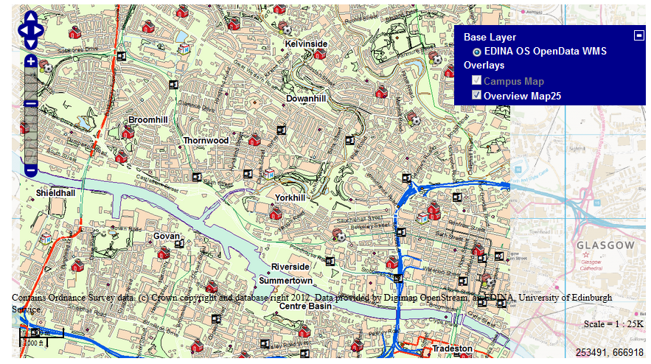
OpenLayers: http://openlayers.org/
http://gogeo.blogs.edina.ac.uk

Slide 11
Considerations
Traffic
Google etc. have caps above which they charge
Hosted or Download?
Easier to use hosted but can be more stable to download the code
Projection and conversion
Different datasets can be in different projections
APIs tend to use Web Mercator
Different conversions have different accuracies
Default is usually poor! Ask edina@ed.ac.uk for advice
http://gogeo.blogs.edina.ac.uk

Slide 12
Spatial data without maps
Other ways to represent spatial data

Slide 13
Geospatial data: it isn’t just all about maps
Most data has an element that is geospatial or can be georeferenced
Postcode, Place name, Location Stamp, IP Address
Get data with coordinates
http://poi.gps-data-team.com/
Use a “Gazetteer Service” to add coordinates to your data
Unlock Places, Here Places
http://gogeo.blogs.edina.ac.uk

Slide 14
Unlock: http://unlock.edina.ac.uk/home/
Unlock Places
Build spatial queries from user or sensor inputs
Return results in several different formats:
kml, json, xml, txt, georss…
Returns, points, bounding boxes, footprints…
Unlock Text
generates a list of places from a txt or html file
RESTful Client
Geoparser made by the LTG here in Informatics
http://gogeo.blogs.edina.ac.uk

Slide 15
Where’s the nearest Hotel?
Enter Location
Get Location from device’s GPS
Hilton Edinburgh Grosvenor: 0.2 miles
Edinburgh residence: 0.4 miles
Holiday Inn Edinburgh North: 1.2 miles
100 metres turn right into Princes Street
500 metres turn left onto Hanover street
50 metres turn left onto George Street
Unlock Places
App
Coordinates
Coordinates
Unlock Places
Geonames feature type: Hotel
http://gogeo.blogs.edina.ac.uk

Slide 16
Questions?
http://gogeo.blogs.edina.ac.uk

